Slide 1

Web Storages
Cookies, Local and Session Storage
Telerik Software Academy
Learning & Development Team
http://academy.telerik.com

Slide 2
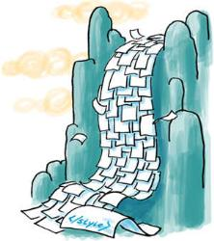

Table of Contents
Cookies
SessionStorage
LocalStorage
Shims for localStorage and sessionStorage

Slide 3
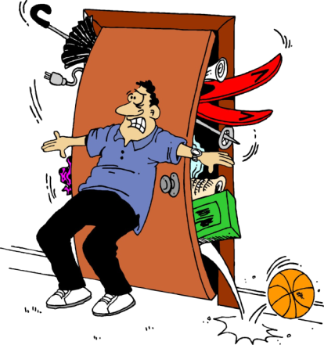

WebStorages
Cookies, Local and Session

Slide 4
WebStorages
WebStorages are places to store data
Save user settings, so next time he opens the application, they can be loaded
Three common types of Web Storage
Cookies
Accessible only from a single document
localStorage
Accessible only from a single document
sessionStorage
Accessible only while the document is opened

Slide 5
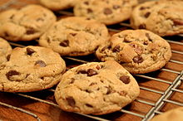
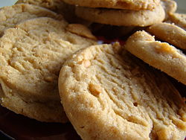
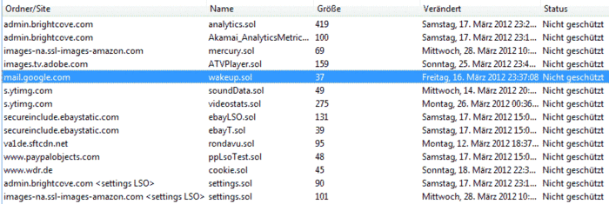
Cookies

Slide 6
Cookies
Cookies are small pieces of data
Accessible from a concrete application
Stored in the user's browsers
i.e. different cookies for different browsers
Cookies can store only plain text

Slide 7
Cookies (2)
Cookies are used to save some state of the user preferences and settings
If you have authenticated to the server once, it is not necessary to do so again
Cookies are attached to the headers of every HTTP request to the server
Cookies can be read and set by JavaScript

Slide 8
Cookies (3)
A cookie consists of three parts
A name-value pair that holds the cookie information
An expire date, after which this cookie is not available
A domain and path to the server, that the cookie belongs to

Slide 9
Cookies (4)
Name-value pairs hold the cookie's data
The name is used to reach the data stored in the value
To read a cookie, you must search for the name
Expire date
Used to give timeframe for the work of the cookie
If not set, the cookie is removed when closing the browser
To make a forever cookie, set the expire date after enough years

Slide 10
Working with Cookies
Cookies can be accessed with JavaScript
Use document.cookie property
Thought cookies are not strings, they are used as strings
//sets a cookie
document.cookie =
'c1=cookie1; expires=Thu, 30 Apr 2013 21:44:00 UTC; path=/'
//sets another cookie
document.cookie =
'c2=cookie2; expires=Tue, 29 Apr 2013 11:11:11 UTC; path=/'
//reads all cookies
console.log(document.cookie);

Slide 11
Working with Cookies
Read cookie (its information)
function readCookie(name) {
var allCookies = document.cookie.split(";");
for (var i = 0; i < allCookies.length; i++) {
var cookie = allCookies[i];
var trailingZeros = 0;
for (var j = 0; j < cookie.length; j++) {
if (cookie[j] !== " ") {
break;
}
}
cookie = cookie.substring(j);
if (cookie.startsWith(name + "=")) {
return cookie;
}
}
}

Slide 12
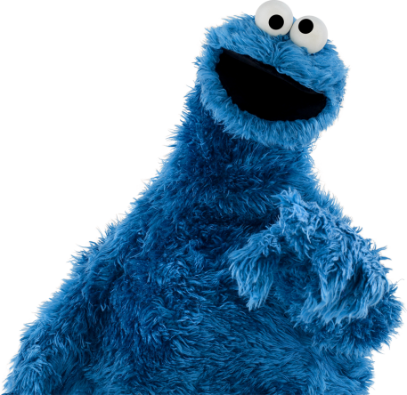
Cookies
Live Demo

Slide 13
localStorage
localStorage is per document storage
Accessible through document.localStorage
Similar to cookies
Can store much larger amount of data
Supported down to IE8
Needs a shim for IE7
Saves data as string
localStorage properties:
setItem(key, value), getItem(key)
removeItem(key), length

Slide 14
Local Storage Example
Local Storage
function saveState(text){
localStorage["text"] = text;
}
function restoreState(){
return localStorage["text"];
}
Same as
function saveState(text){
localStorage.setValue("text", text);
}
function restoreState(){
return localStorage.getValue("text");
}

Slide 15

localStorage
Live Demo

Slide 16
Session Storage
Session Storage
Similar to localStorage
Lasts as long as browser is open
Opening page in new window or tab starts new session
Great for sensitive data (e.g. banking sessions)
Can store only strings

Slide 17
Session Storage Example
Session Storage
function incrementLoads() {
if (!sessionStorage. counter) {
sessionStorage.setItem(" counter ", 0);
}
var currentCount =
parseInt(sessionStorage.getItem("counter"));
currentCount++;
sessionStorage.setItem("counter",currentCount;
document.getElementById("countDiv").innerHTML =
currentCount;
}

Slide 18
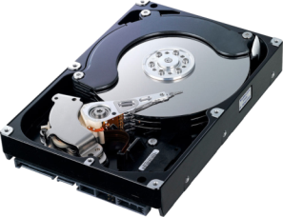

sessionStorage Storages
Live Demo

Slide 19
Saving Object in WebStorages
Local and session storage can only contain strings
If you try to save an object, its toString() method will be invoked
To save objects into web storages, need to extend the Storage prototype
Storage.prototype.setObject =
function setObject(key, obj){
this.setItem(key, JSON.stringify(obj));
};
Storage.prototype.getObject =
function getObject(key) {
return JSON.parse(this.getItem(key));
};

Slide 20
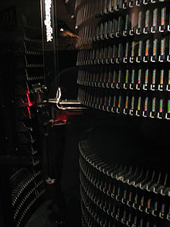
Saving Object in WebStorages
Live Demo

Slide 21
Web Storages

Slide 22
Homework
Create a simple number guessing game
The computer generates a random number with four different digits
The leftmost digit must not be 0 (zero)
For simplicity called abcd
At each turn the player enters a four-digit number
For simplicity called xyzw
When the game ends:
Ask the player for a nickname
Save the nickname inside the localStorage
Implement a high-score list

Slide 23
Homework (2)
(cont.) Create a simple number guessing game
Sheep means that a digit from xyzw is contained in abcd, but not on the same position
If two such digits exists, the sheep are 2
Ram means that a digit from xyzw is contained in abcd and it is on the same position
If two such digits exists, the rams are 2
The game continues until the player guesses the number abcd
i.e. has 4 rams

